Slide 1

Clustering Event Logs Using Iterative Partitioning
Tokunbo Makanju, A. Nur Zincir-Heywood, Evangelos E. Milios
Faculty of Computer Science
Dalhousie University
Nova Scotia, Canada

Slide 2

INTRODUCTION
Event logs provide an audit trail of events that occur on a computer system.
Difficult to analyze them manually.
Tools and techniques are required for the automatic analysis of these logs.
  Misuse detection
  Failure prediction
  Root cause analysis
<number> Network Information Management and Security Group
http://projects.cs.dal.ca/projectx

Slide 3
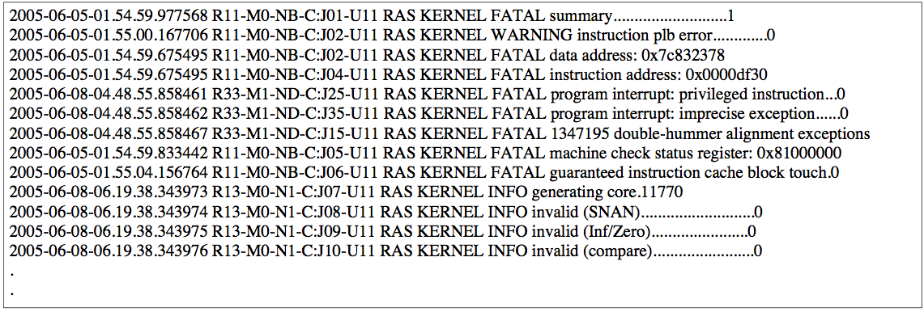
EXAMPLE LOG FILE
<number> Network Information Management and Security Group
http://projects.cs.dal.ca/projectx

Slide 4

PARTS OF AN EVENT
2005-06-05-01.54.59 R11-M0 RAS KERNEL WARNING invalid SNAN…..0
TIMESTAMP
HOST
CLASS
FACILITY
SEVERITY
TOKENS
HEADER
MESSAGE
EVENT
EVENT SIZE: This refers to the number of tokens in the MESSAGE field.
<number> Network Information Management and Security Group
http://projects.cs.dal.ca/projectx

Slide 5
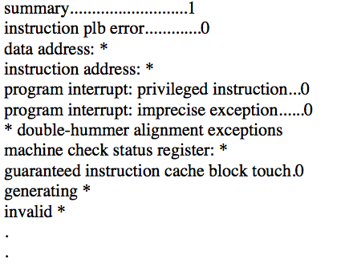
CLUSTERING EVENTS / MESSAGE TYPE EXTRACTION
<number> Network Information Management and Security Group
http://projects.cs.dal.ca/projectx

Slide 6

IPLoM
Iterative Partitioning Log Mining
Goals
IPLoM: Design a message type extraction algorithm that is able to
  Find all messages that may exist in a log file.
  Find message types irrespective of the frequency of its instances in the log data.
  Find message types at an abstraction level preferred by a human observer.
<number> Network Information Management and Security Group
http://projects.cs.dal.ca/projectx

Slide 7
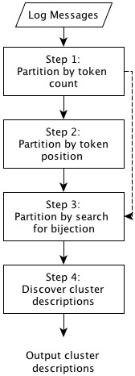
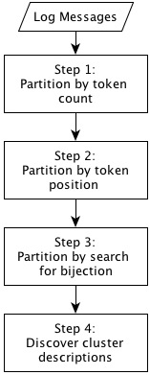
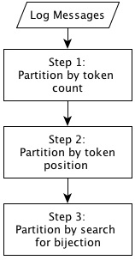
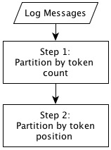
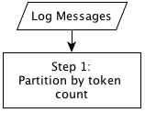

IPLoM
Overview
<number> Network Information Management and Security Group
http://projects.cs.dal.ca/projectx

Slide 8
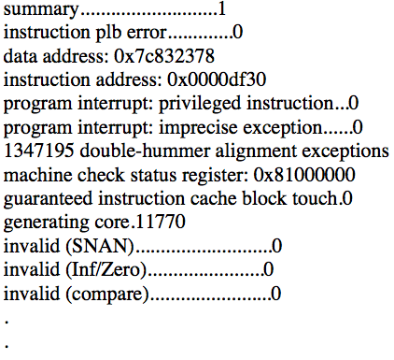
Data Preparation: Obtain Messages from Events
<number> Network Information Management and Security Group
http://projects.cs.dal.ca/projectx

Slide 9
STEP 1: Partition by Event Size
Summary…………..1
.
Invalid (SNAN)……….0
.
Data address: 0x7c832378
Summary…………..1
.
.
Invalid (SNAN)……….0
.
.
Data address: 0x7c832378
.
.
1
2
3
<number> Network Information Management and Security Group
http://projects.cs.dal.ca/projectx

Slide 10
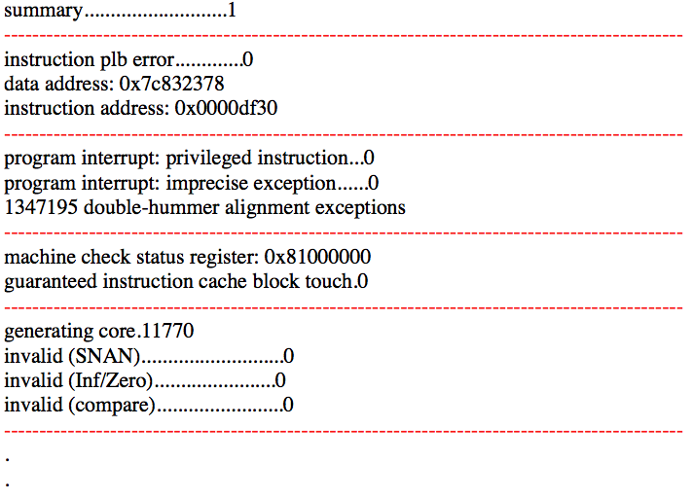
STEP 1: Partition by Event Size
1
3
4
5
2
<number> Network Information Management and Security Group
http://projects.cs.dal.ca/projectx

Slide 11
STEP 2: Partition by Token Position
instructor plb error……..0
Instruction address: 0x0000df30
Data address: 0x7c832378
Instructor plb error……0
Instruction address: 0x0000df30
Data address: 0x7c832378
<number> Network Information Management and Security Group
http://projects.cs.dal.ca/projectx

Slide 12
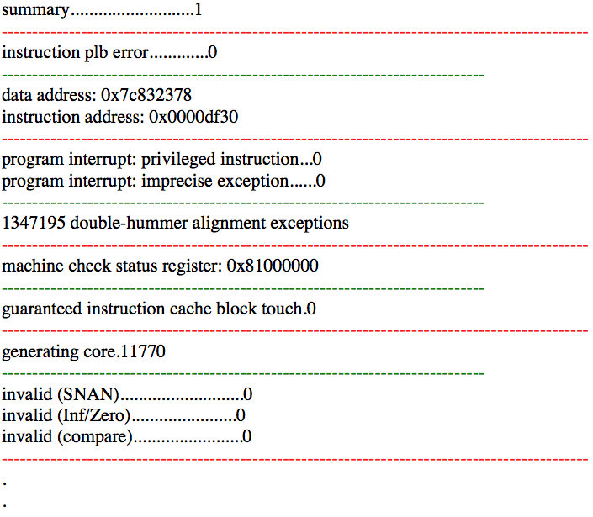
STEP 2: Partition by Token Position
<number> Network Information Management and Security Group
http://projects.cs.dal.ca/projectx

Slide 13
STEP 3: Partition by Search for Bijection
program interrupt: privileged instruction
program interrupt: imprecise exception
program interrupt: privileged instruction
program interrupt: imprecise exception
<number> Network Information Management and Security Group
http://projects.cs.dal.ca/projectx

Slide 14
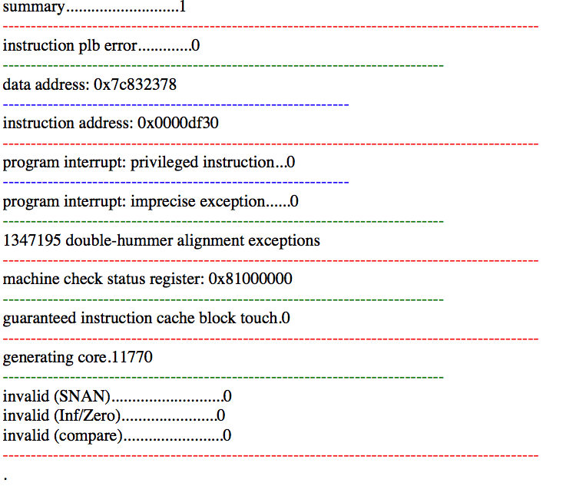
STEP 3: Partition by Search for Bijection
<number> Network Information Management and Security Group
http://projects.cs.dal.ca/projectx

Slide 15
STEP 4: Discover Cluster Descriptions
invalid
Invalid
invalid
(SNAN)……0
(Inf/Zero)…..0
compare…..0
>1
1
*
invalid
<number> Network Information Management and Security Group
http://projects.cs.dal.ca/projectx

Slide 16
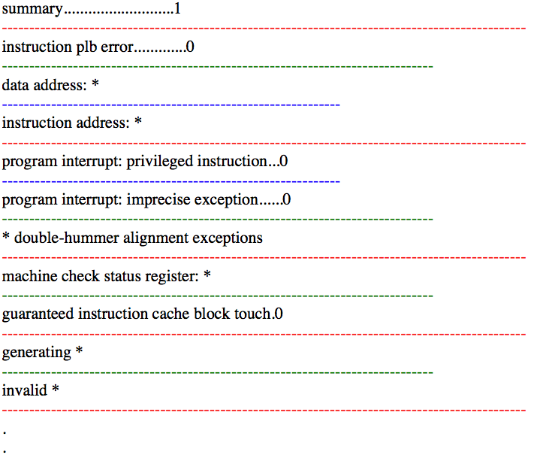
STEP 4: Discover Cluster Descriptions
<number> Network Information Management and Security Group
http://projects.cs.dal.ca/projectx

Slide 17
Output Cluster Description Set
<number> Network Information Management and Security Group
http://projects.cs.dal.ca/projectx

Slide 18
Experiments
Collected 7 datasets produced by different applications
  Datasets from different sources.
  Heterogeneous content.
Produced message types for the datasets manually.
  Work done by Dalhousie CS Tech Support.
Produced message types using IPLoM, SLCT, Loghound and Teiresias.
Evaluated the performance of the algorithms by comparing their output with manual type as gold standard.
<number> Network Information Management and Security Group
http://projects.cs.dal.ca/projectx

Slide 19
Calculating Precision, Recall and F-Measure
Manual
Automatic
FN
TP
FP

Slide 20
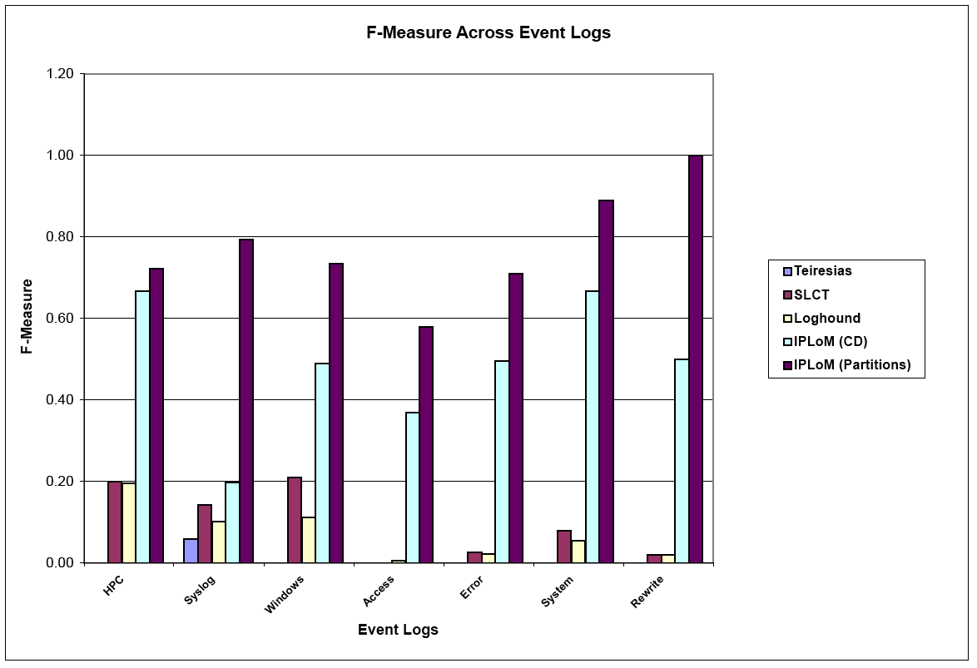
Results: F-Measure Performance
F-Measure Performance
<number> Network Information Management and Security Group
http://projects.cs.dal.ca/projectx

Slide 21
CONCLUSION
IPLoM is a novel message type clustering algorithm which is
  Lightweight
  Accurate
Parameter optimization may further improve the results of IPLoM.
Using the results of IPLoM in other automatic log analysis tasks.
<number> Network Information Management and Security Group
http://projects.cs.dal.ca/projectx

Slide 22

Thank you!
<number> Network Information Management and Security Group
http://projects.cs.dal.ca/projectx

Slide 23
APPENDIX
<number> Network Information Management and Security Group
http://projects.cs.dal.ca/projectx

Slide 24
PREVIOUS WORK
Event Type Extraction Tools.
  Teiresias - 1998
  Simple Log File Clustering Tool (SLCT) - 2003
  Loghound - 2004
<number> Network Information Management and Security Group
http://projects.cs.dal.ca/projectx

Slide 25
BACKGROUND
Definitions
EVENT LOG: A text based audit trail of events that occur within the applications on a computer system.
EVENT: An independent line of text within an event log which details a single occurrence. An event is also sometimes referred to as a message or transaction in the literature.
TOKEN: A single word delimited by white space within a line of text in an event log.
EVENT SIZE: The number of individual tokens in the “message” field of an event.
MESSAGE CLUSTER/MESSAGE TYPE: These are “message” field entries within an event log produced by the same print statement.
MESSAGE TYPE DESCRIPTION/MESSAGE LINE FORMAT: Textual template which contains wildcards which can be used to represent all members of an event cluster.
<number> Network Information Management and Security Group
http://projects.cs.dal.ca/projectx

Slide 26
BACKGROUND
Event Clusters/ Message Types
Messages in event logs do contain a certain amount of structure
  Produced by the same print statement
    The line of C code: sprintf(message, Connection from %s on port %d, ipaddress, portnumber);
    Would produce the lines: “Connection from 192.34.6.8 on port 80” and “Connection from 192.34.6.9 on port 25”
    These lines can be represented by the string template: “Connection * from *”
  Discovering message types is not trivial.
A message type extraction:
  Takes as input the free form message fields from an event log.
  Produces as output the event clusters and/or message type descriptions.
<number> Network Information Management and Security Group
http://projects.cs.dal.ca/projectx

Slide 27
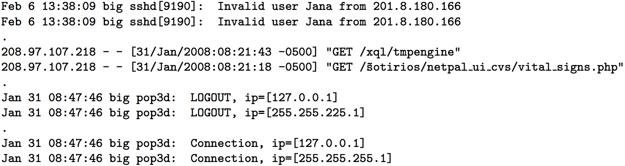
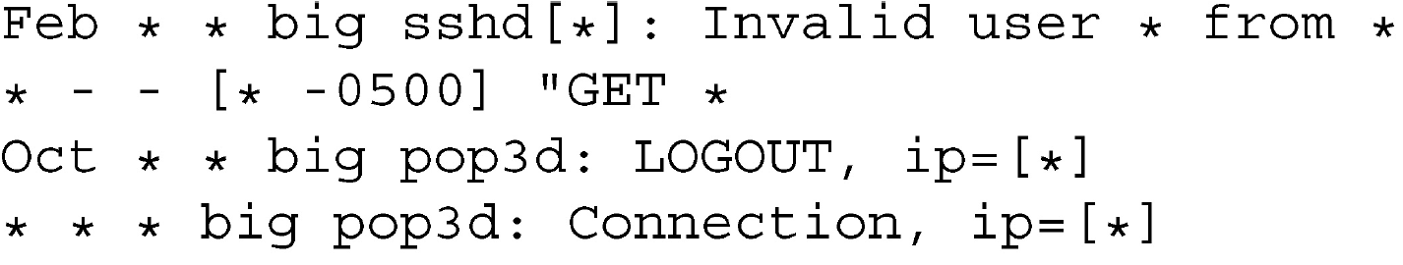
BACKGROUND
Message Clusters/ Event Types (contd.)
Message type extraction:
Processing by message type extraction algorithm
<number> Network Information Management and Security Group
http://projects.cs.dal.ca/projectx

Slide 28
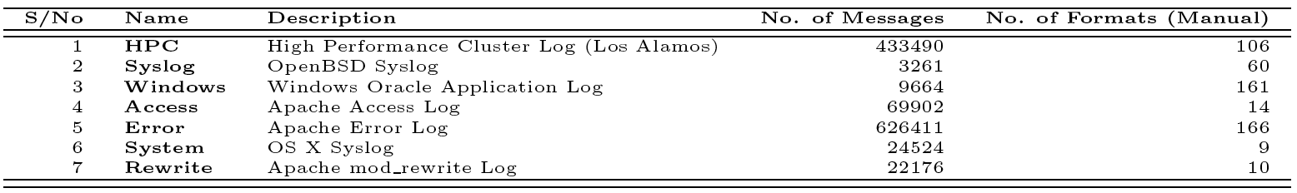
Dataset Summary
<number> Network Information Management and Security Group
http://projects.cs.dal.ca/projectx

Slide 29
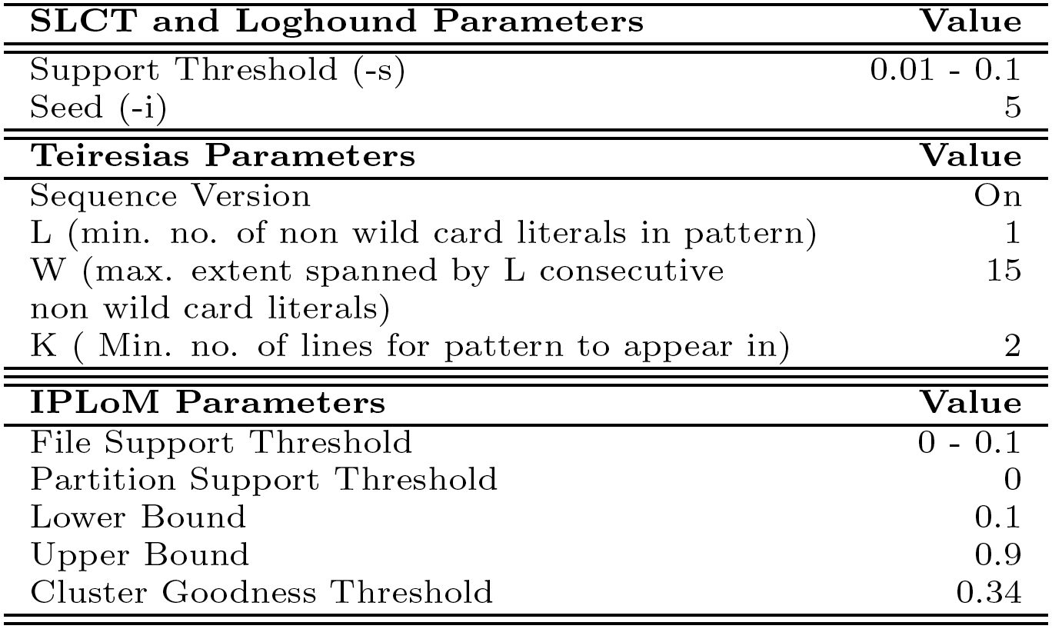
Algorithm Parameters
<number> Network Information Management and Security Group
http://projects.cs.dal.ca/projectx

Slide 30
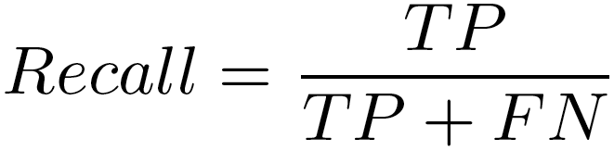
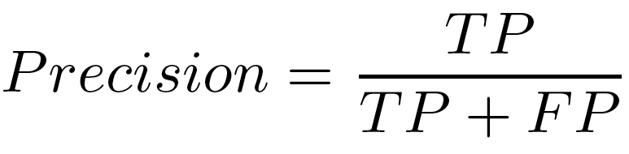
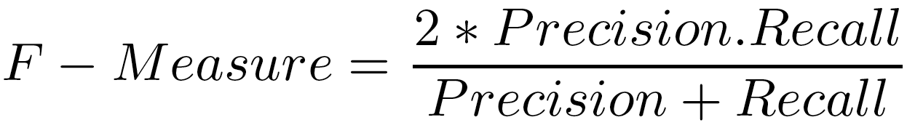
Evaluation Techniques
Recall
Precision
F-Measure
An automatically produced line format must match a manually produced line format exactly to be considered a TP.
<number> Network Information Management and Security Group
http://projects.cs.dal.ca/projectx

Slide 31
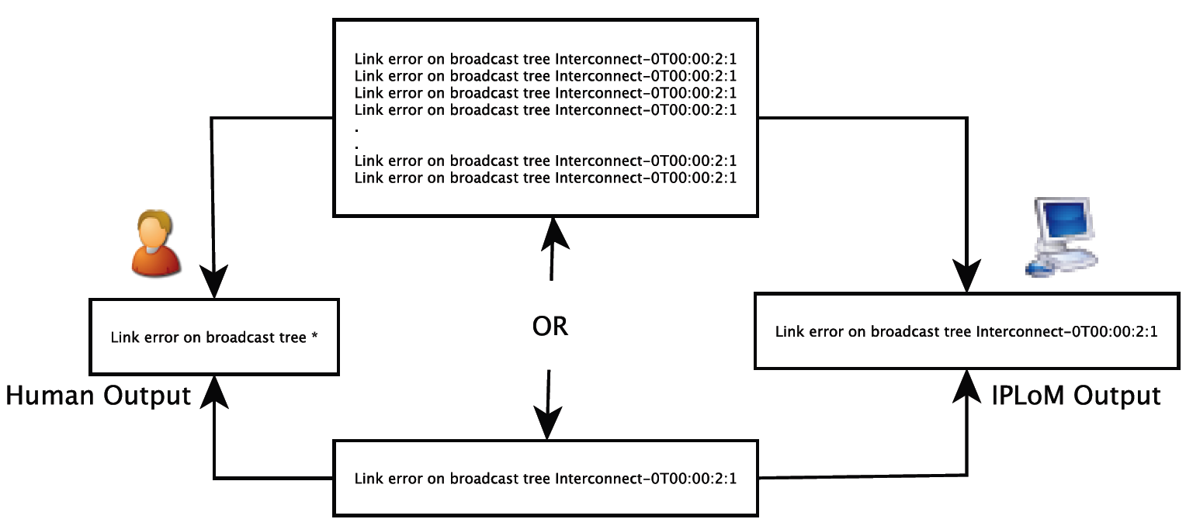
Scenario: Insufficient Information in Data
<number> Network Information Management and Security Group
http://projects.cs.dal.ca/projectx

Slide 32
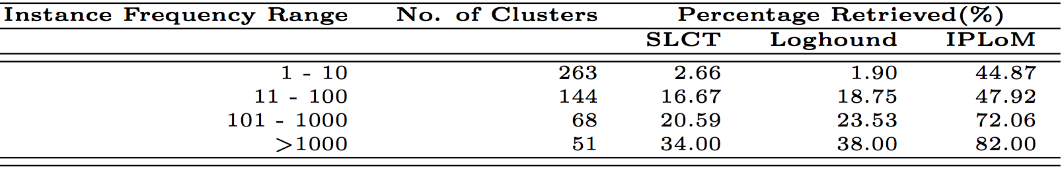
Performance Based on Cluster Instance Frequency
Performance of all algorithms suffers as the number instances in the cluster decrease.
IPLoM showed more resilience in finding clusters with few instances.
<number> Network Information Management and Security Group
http://projects.cs.dal.ca/projectx

Slide 33
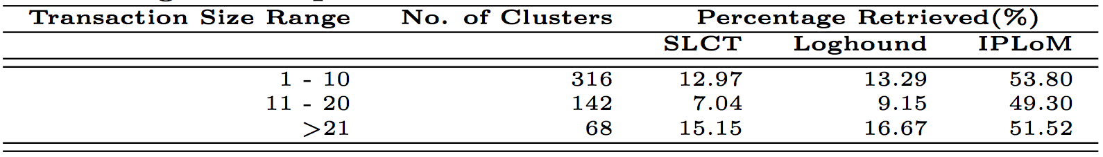
Performance Based on event size
SLCT and Loghound show a drop in performance for mid-size types.
IPLoM’s performance is stable across all event size categories
<number> Network Information Management and Security Group
http://projects.cs.dal.ca/projectx

Slide 34
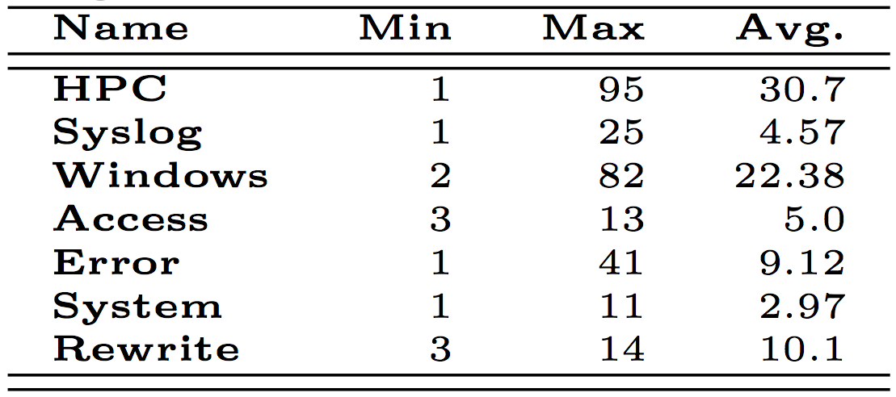
Effect of event size on computational complexity
The computational complexity of the Apriori algorithm is directly proportional to the event size and inversely proportional to the support value.
The HPC file has the highest average event size
Loghound crashed for the HPC file when it is run with a line count support value of 2.
SLCT and IPLoM do not have this problem.
<number> Network Information Management and Security Group
http://projects.cs.dal.ca/projectx

Slide 35
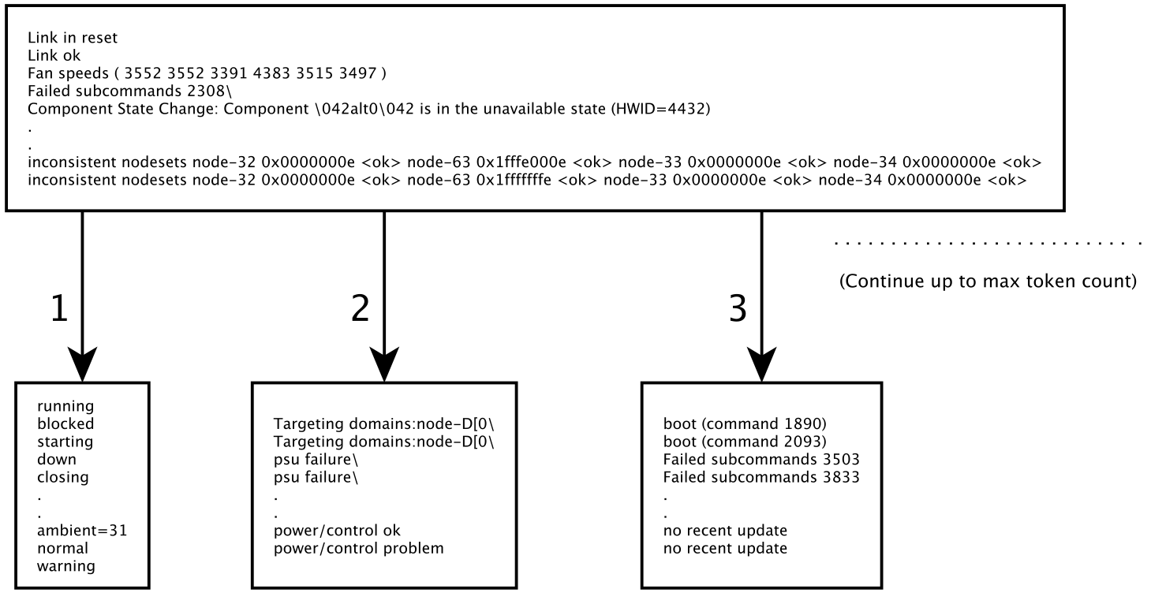
APPENDIX : IPLoM STEP-1
<number> Network Information Management and Security Group
http://projects.cs.dal.ca/projectx

Slide 36
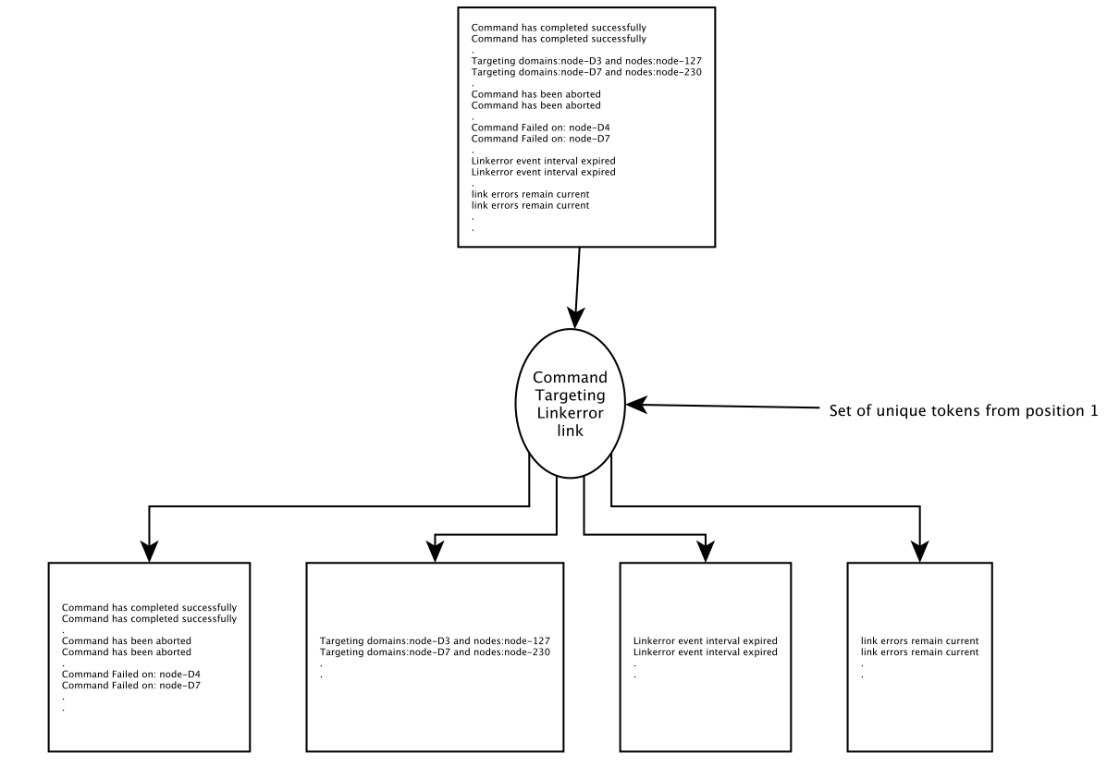
APPENDIX : IPLoM STEP-2
<number> Network Information Management and Security Group
http://projects.cs.dal.ca/projectx

Slide 37
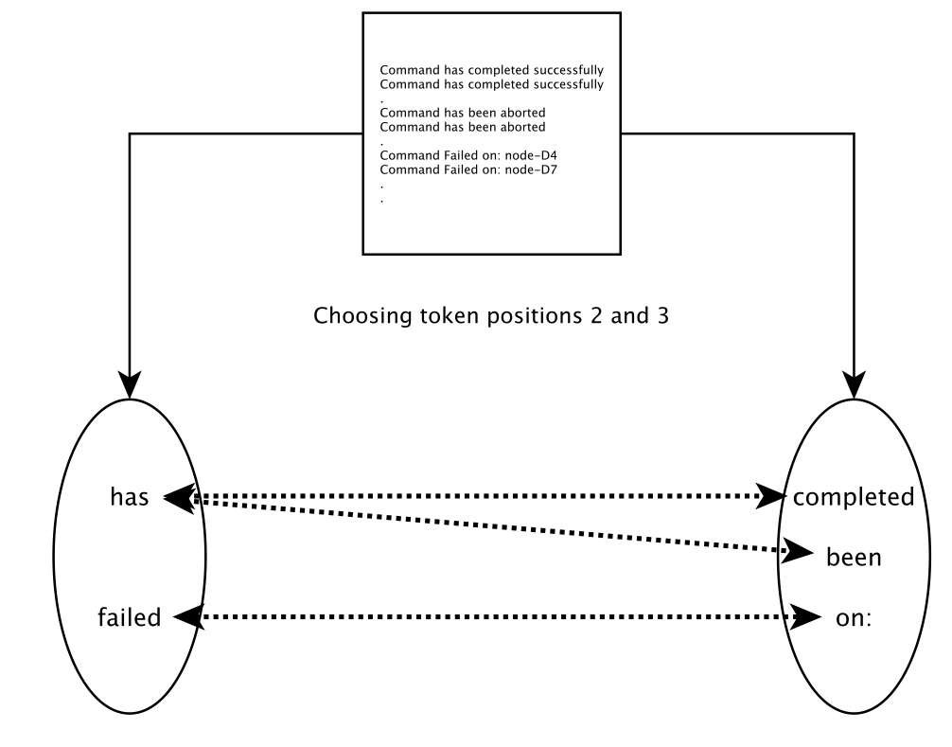
APPENDIX : IPLoM STEP-3
<number> Network Information Management and Security Group
http://projects.cs.dal.ca/projectx

Slide 38
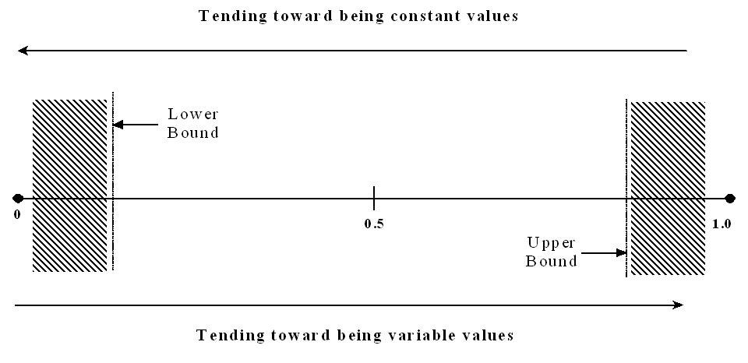
APPENDIX: 1-M Split decision making
<number> Network Information Management and Security Group
http://projects.cs.dal.ca/projectx

Slide 39
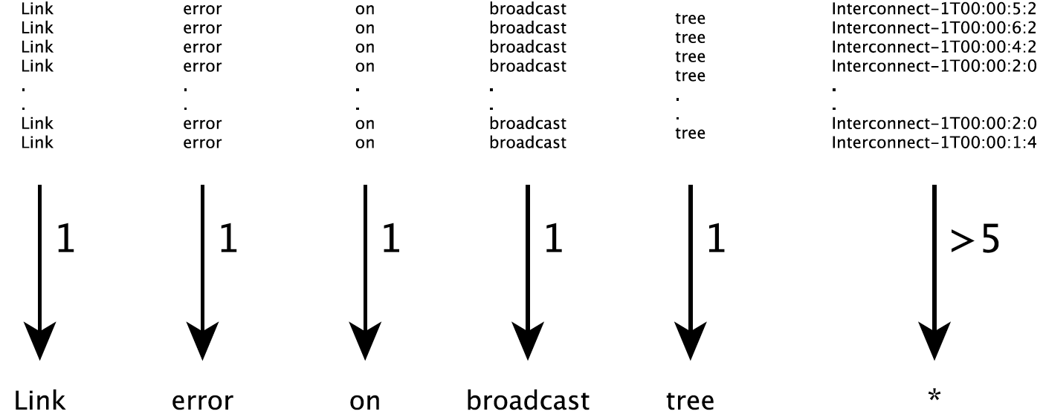
APPENDIX : IPLoM STEP-4
<number> Network Information Management and Security Group
http://projects.cs.dal.ca/projectx

Slide 40
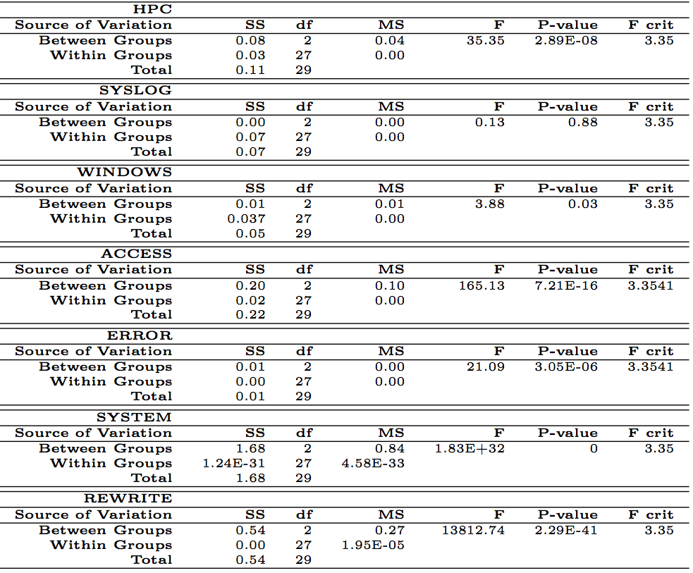
APPENDIX - ANOVA Recall
<number> Network Information Management and Security Group
http://projects.cs.dal.ca/projectx

Slide 41
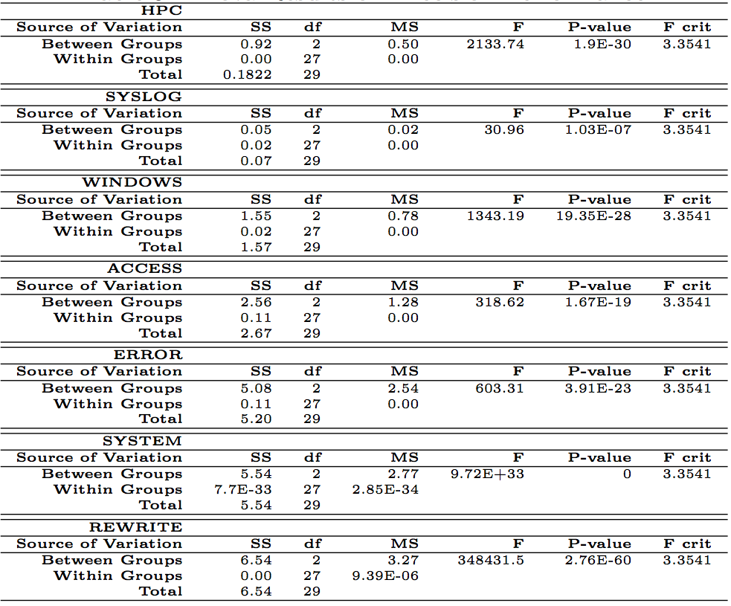
Appendix- ANOVA Precision
<number> Network Information Management and Security Group
http://projects.cs.dal.ca/projectx

Slide 42
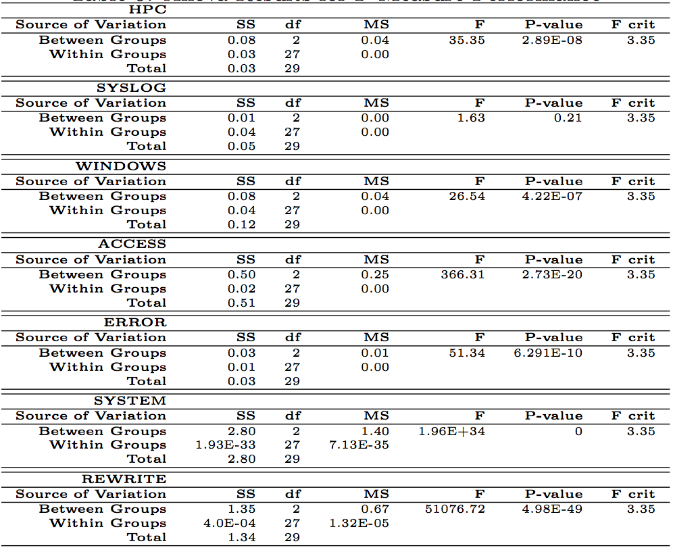
APPENDIX - ANOVA F-Measure
<number> Network Information Management and Security Group
http://projects.cs.dal.ca/projectx

Slide 43
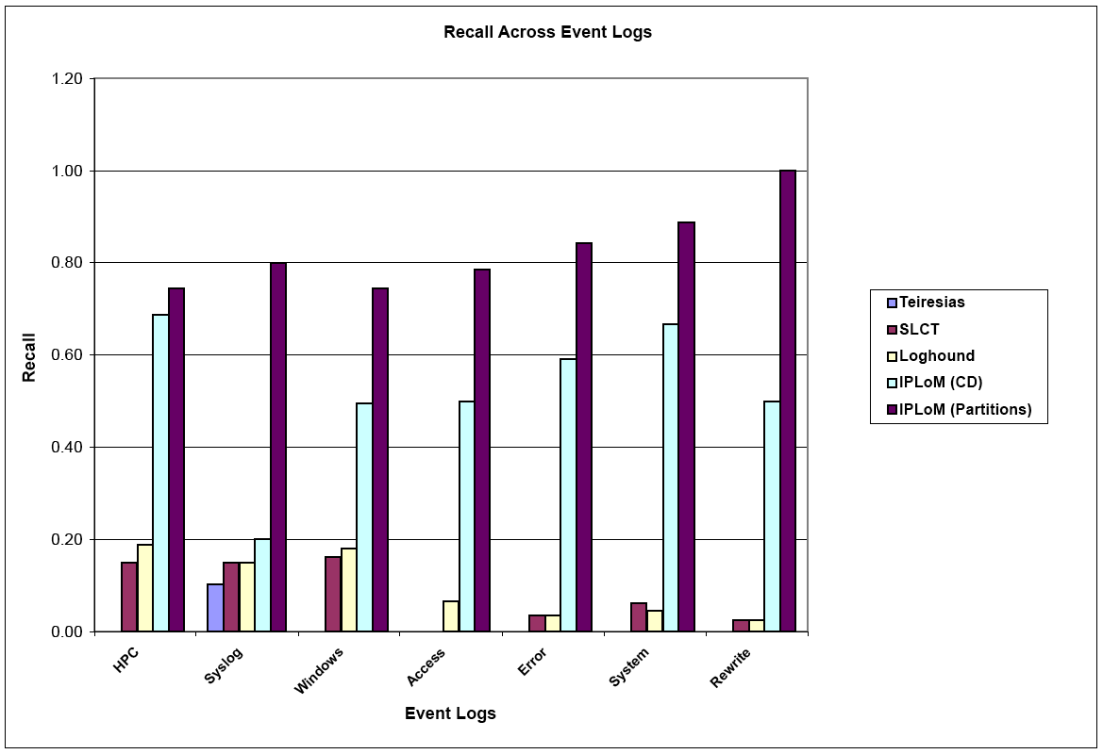
APPENDIX
Results: Recall Performance
Recall Performance
<number> Network Information Management and Security Group
http://projects.cs.dal.ca/projectx

Slide 44
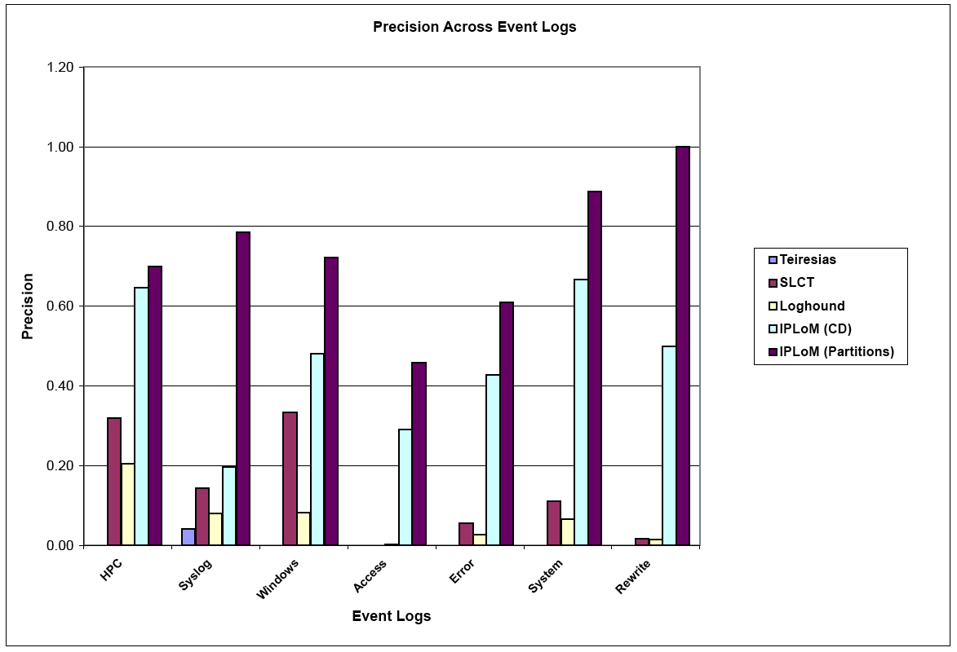
APPENDIX
Results: Precision Performance
Precision Performance
<number> Network Information Management and Security Group
http://projects.cs.dal.ca/projectx

